Slide 1
Descriptive Statistics Part -2
Sourav Karmakar
souravkarmakar29@gmail.com

Slide 2
Relationships among Variables
While it is important to know how to describe the distribution of a single variable, most studies pose questions that involve exploring the relationship between two variables using the collected data. Here are a few examples of such questions with the two variables highlighted:
Y
X
1. How is the number of calories in a sandwich related to the type of sandwich (veg, egg or chicken)
Y
X
2. Are the smoking habits of a person (yes/no) related to the person's gender (male/female)?
X
Y
3. What is the relationship between a person’s age and farsightedness?
X
Y
4. Is there a relationship between gender and test scores on a particular standardized test?
Y
X
5. Can you predict a person's favorite type of music (classical, rock, jazz) based on his/her Age?
In most studies involving two variables, each of the variables has a role. We distinguish between:
The explanatory variable (also commonly referred to as the independent variable) — the variable that claims to explain, predict or affect the response. Typically, it is denoted by X.
The response variable (also commonly referred to as the dependent variable) — the outcome of the study. Denoted by Y.
Can you predict the X and Y of above examples?

Slide 3
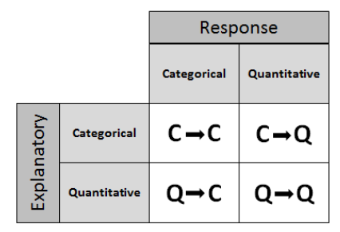
Relationships among Variables
If we further classify each of the two relevant variables according to type (categorical or quantitative), we get the following 4 possibilities for “role-type classification”
Categorical explanatory and quantitative response (C → Q)
Categorical explanatory and categorical response (C → C)
Quantitative explanatory and quantitative response (Q → Q)
Quantitative explanatory and categorical response (Q → C)
1. How is the number of calories in a sandwich related to (or affected by) the type of sandwich (veg, egg or chicken)
Ans: C → Q
2. Are the smoking habits of a person (yes/no) related to the person's gender (male/female)?
Ans: C → C
Ans: Q → Q
3. What is the relationship between a person’s age and farsightedness?
Ans: C → Q
4. Is there a relationship between gender and test scores on a particular standardized test?
Ans: Q → C
5. Can you predict a person's favorite type of music (classical, rock, jazz) based on his/her Age?

Slide 4
C → C Relationships
A survey is done among 1200 college students and they were asked how do they feel about their body-image (over-weight / under-weight/ about right) . The table of the data looks like following:
Student | Gender | Body-Image
1 | M | over-weight
2 | M | about-right
3 | F | over-weight
. . . | . . . | . . .
1198 | F | under-weight
1199 | M | about-right
1200 | F | over-weight
Suppose we ask questions like:
Are men and women just as likely to think their weight is about-right?
Is there a difference between the genders in feelings about body image?
To answer these type of questions we need to examine the relationship between two categorical variables, gender and body image.
Here Gender is Explanatory variable and Body Image is the Response variable
Explanatory
Response
In order to summarize the relationship between two categorical variables, we create a display called a two-way table.

Slide 5
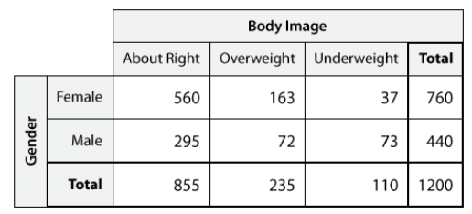
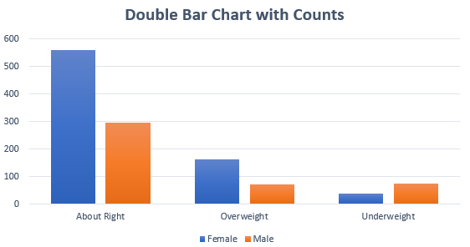
C → C Relationships
Two Way Table:
This Total gives the summary of the categorical variable Gender
This Total gives the summary of the categorical variable Body Image
A way to visualize the distribution of categorical variables and relationship among them is to plot a Double Bar Chart

Slide 6
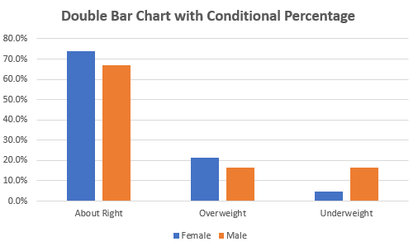
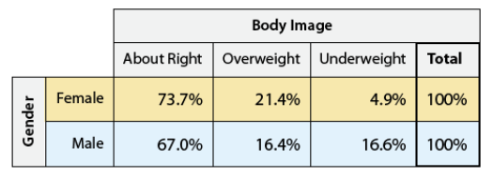
C → C Relationships
As we are examining the relationship among gender and body image, hence we create a conditional percentage table and plot corresponding Double Bar Chart

Slide 7
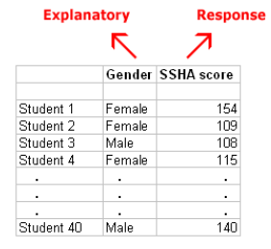
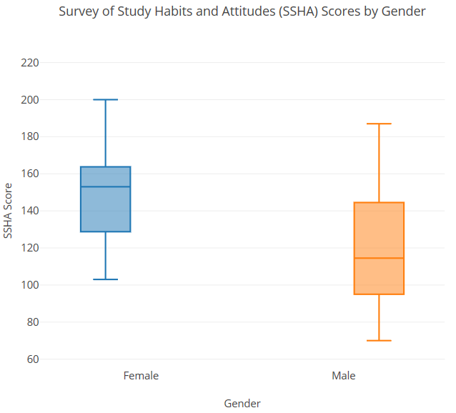
C → Q Relationships
The Survey of Study Habits and Attitudes (SSHA) is a psychological test designed to measure the motivation, study habits, and attitudes toward learning of college students. Is there a relationship between gender and SSHA scores? In other words, is there a "gender effect" on SSHA scores? Data were collected from 40 randomly selected college students, and here is what the raw data look like:
Following is the Five-number summary of SSHA score separated Gender-wise
Side-by-side boxplots supplemented by descriptive statistics allow us to compare the distribution of SSHA scores within each category of the explanatory variable gender:
Statistic | Female | Male
min | 103 | 70
Q1 | 128.75 | 95
Median | 153 | 114.5
Q3 | 163.75 | 144.5
Max | 200 | 187

Slide 8
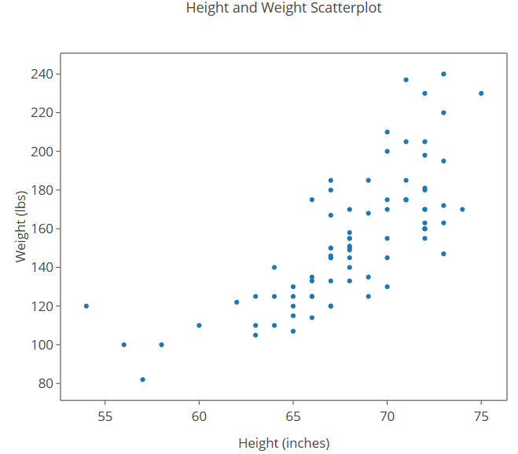
Q → Q Relationships
We look at height and weight data that were collected from 57 males and 24 females and use the data to explore how the weight of a person is related to (or affected by) his or her height. This implies that height will be our explanatory variable and weight will be our response variable. The dataset look something like following:
Sl. No. | height (inches) | weight (lbs) | male
1 | 67 | 115.3 | 1
2 | 62 | 120 | 0
3 | 73.5 | 142 | 1
. . . | . . . | . . . | . . .
79 | 71 | 175 | 1
80 | 63 | 125 | 0
81 | 58 | 100 | 0
We create scatter plots from the given data which looks like the one shown beside.
Drawing scatter plot is simple. You just have to plot each points specified by the co-ordinates. Here the co-ordinates are (height, weight)

Slide 9
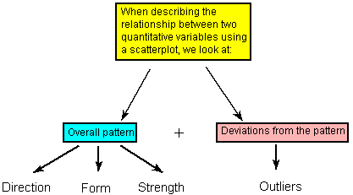
Q → Q Relationships
Interpreting the Scatterplot: How do we explore the relationship between two quantitative variables using the scatterplot?
Recall that when we described the distribution of a single quantitative variable with a histogram, we described the overall pattern of the distribution (shape, center, spread) and any deviations from that pattern (outliers). We do the same thing with the scatterplot.

Slide 10
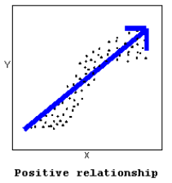
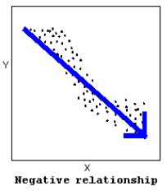
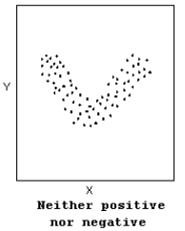
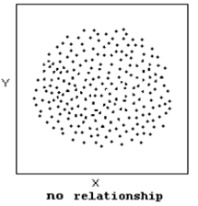
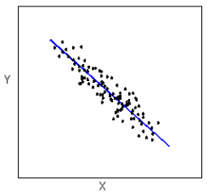
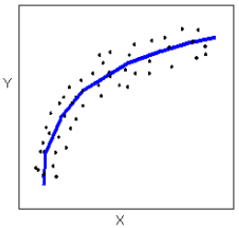
Q → Q Relationships
The direction of the relationship can be positive, negative, or neither:
The form of the relationship is its general shape. When identifying the form, we try to find the simplest way to describe the shape of the scatterplot. There are many possible forms.
Linear
Curvilinear

Slide 11
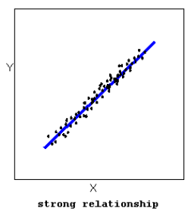
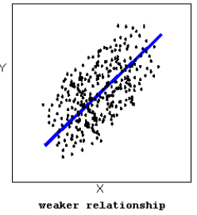
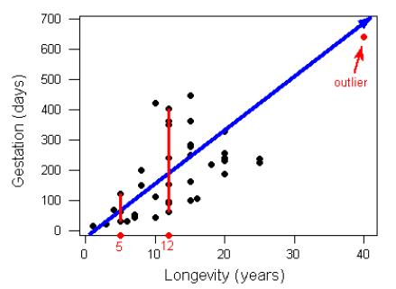
Q → Q Relationships
The strength of the relationship is determined by how closely the data follow the form of the relationship. Let's look, for example, at the following two scatterplots displaying positive, linear relationships:
Consider the following dataset. There is one outlier spotted in the dataset.
Can you guess the direction of the relationship?
Can you guess the form of the relationship?
Can you guess the strength of the relationship?
Positive
Linear
Weak

Slide 12

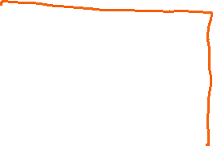








Slide 13















Slide 14




















Slide 15









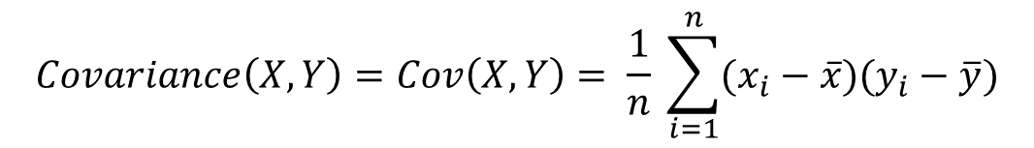
















Q → Q Relationships
The Covariance (Cov):
The covariance between two quant. variable measures how variation in one variable affects the variation in another.
Calculation: The covariance between two quantitative variable, X and Y is calculated as following:
X | x₁ | x₂ | x₃ | . . . | x_{n-2} | x_{n-1} | x_{n}
Y | y₁ | y₂ | y₃ | . . . | y_{n-2} | y_{n-1} | y_{n}
$$Covariance\left(X,Y\right)=Cov\left(X,Y\right)= \frac{1}{n} \sum_{i=1}^{n}{(x_{i}−\overline{x})(y_{i}−\overline{y})}$$
Intuition of Covariance:
Covariance < 0
Covariance $≈$ 0
$$Y$$
Covariance > 0
$$Y$$
$$Y$$
$$\left(x_{i}−\overline{x}\right)\left(y_{i}−\overline{y}\right)<0$$
$$\left(x_{i}−\overline{x}\right)\left(y_{i}−\overline{y}\right)<0$$
$$\left(x_{i}−\overline{x}\right)\left(y_{i}−\overline{y}\right)>0$$
$$\left(x_{i}−\overline{x}\right)\left(y_{i}−\overline{y}\right)>0$$
$$\left(x_{i}−\overline{x}\right)\left(y_{i}−\overline{y}\right)>0$$
$$\left(x_{i}−\overline{x}\right)\left(y_{i}−\overline{y}\right)<0$$
$$\overline{y}$$
$$\overline{y}$$
$$\overline{y}$$
$$\left(x_{i}−\overline{x}\right)\left(y_{i}−\overline{y}\right)<0$$
$$\left(x_{i}−\overline{x}\right)\left(y_{i}−\overline{y}\right)>0$$
$$\left(x_{i}−\overline{x}\right)\left(y_{i}−\overline{y}\right)>0$$
$$\left(x_{i}−\overline{x}\right)\left(y_{i}−\overline{y}\right)<0$$
$$\left(x_{i}−\overline{x}\right)\left(y_{i}−\overline{y}\right)>0$$
$$\left(x_{i}−\overline{x}\right)\left(y_{i}−\overline{y}\right)<0$$
$$\overline{x}$$
$$X$$
$$\overline{x}$$
$$X$$
$$\overline{x}$$
$$X$$
Positive Relationship
Negative Relationship
No Relationship

Slide 16

Q → Q Relationships
The Correlation Coefficient (r):
The numerical measure that assesses the strength of a linear relationship is called the correlation coefficient.
Definition: The correlation coefficient (r) is a numerical measure that measures the strength and direction of a linear relationship between two quantitative variables.
Calculation: The correlation coefficient (r) between two quantitative variable X and Y is calculated as
X | Y
x₁ | y₁
x₂ | y₂
x₃ | y₃
. . . | . . .
x_{n-2} | y_{n-2}
x_{n-1} | y_{n-1}
x_{n} | y_{n}
Let $σx$ and $σy$be the standard deviations of X and Y respectively and there are $n$ data-points. Then the correlation coefficient between X and Y (denoted by $rxy$ is):
$$rxy= \frac{1}{n} \sum_{i=1}^{n}{\left(\frac{xi −\overline{x}}{σx}\right) \left(\frac{yi −\overline{y}}{σy}\right)}$$
Expanding $σx$ and $σy$and noting that $\overline{x}$and $\overline{y}$are the mean of X and Y respectively. Then the correlation coefficient between X and Y (denoted by $rxy$ is) can be written as:
$$rxy= \frac{\sum_{i=1}^{n}{\left(xi − \overline{x}\right)(y_{i} − \overline{y})}}{\sqrt{\sum_{i=1}^{n}{\left(xi −\overline{x}\right)2}} \sqrt{\sum_{i=1}^{n}{(y_{i} − \overline{y}})2}}= \frac{Cov(X,Y)}{\sqrt{Var(X)} \sqrt{Var(Y)}}$$

Slide 17





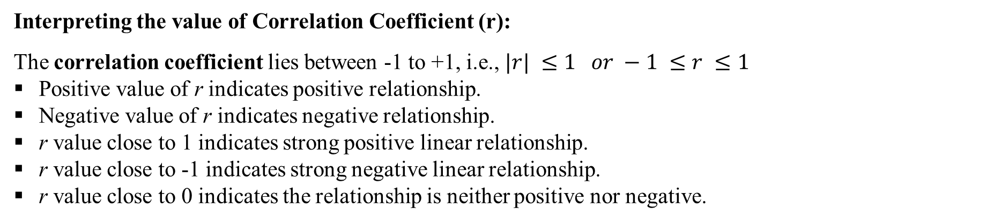
Q → Q Relationships
Interpreting the value of Correlation Coefficient (r):
The correlation coefficient lies between -1 to +1, i.e., $|r| ≤1 or −1 ≤r ≤1$
Positive value of r indicates positive relationship.
Negative value of r indicates negative relationship.
r value close to 1 indicates strong positive linear relationship.
r value close to -1 indicates strong negative linear relationship.
r value close to 0 indicates the relationship is neither positive nor negative.
r = 0.995
r = -0.575
r = 0.436
r = 0.100
r = -0.897

Slide 18









Slide 19
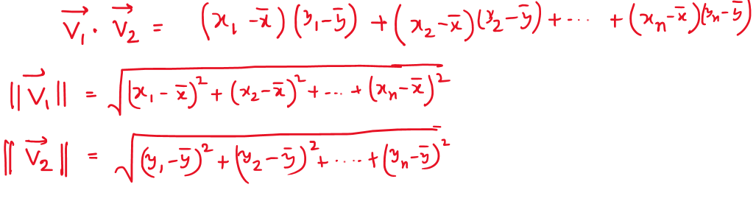


















Slide 20
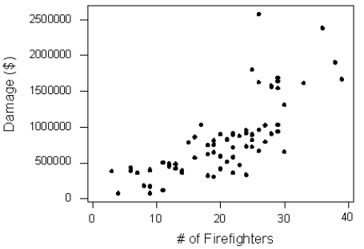
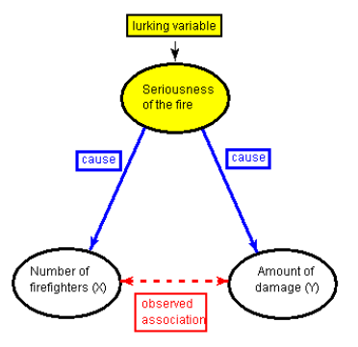
Causation
The scatterplot below illustrates how the number of firefighters sent to fires (X) is related to the amount of damage caused by fires (Y) in a certain city.
The scatterplot clearly displays a strong (slightly curved) positive relationship between the two variables. Would it, then, be reasonable to conclude that sending more firefighters to a fire causes more damage, or that the city should send fewer firefighters to a fire, in order to decrease the amount of damage done by the fire?
Of course not! So, what is going on here?
There is a third variable in the background—the seriousness of the fire—that is responsible for the observed relationship. More serious fires require more firefighters and cause more damage.
Here, the seriousness of the fire is a lurking variable. A lurking variable is a variable that is not among the explanatory or response variables in a study but could substantially affect your interpretation of the relationship among those variables.
Hence, Correlation doesn’t imply Causation

Slide 21
Thank You

